Slide 1
Our vision: a UK without the need for food banks

Slide 2
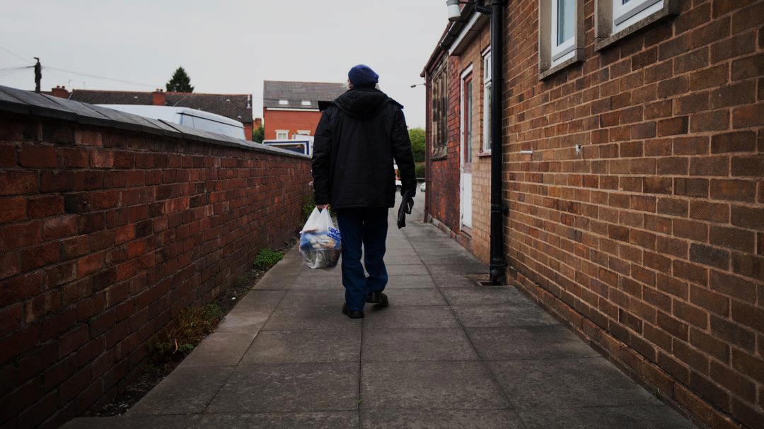
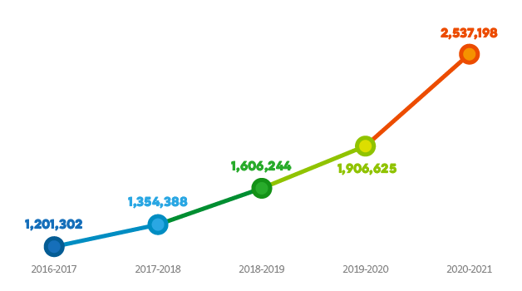
WHY WE EXIST
MORE THAN EVER PEOPLE ARE turning to FOOD BANKS for help
95%
of people referred to food banks are ‘destitute’, meaning their income is too low to cover the cost of essentials
2.5M
people in the UK live in destitution, as a result, there has been a dramatic rise in the number of people using food banks

Slide 3
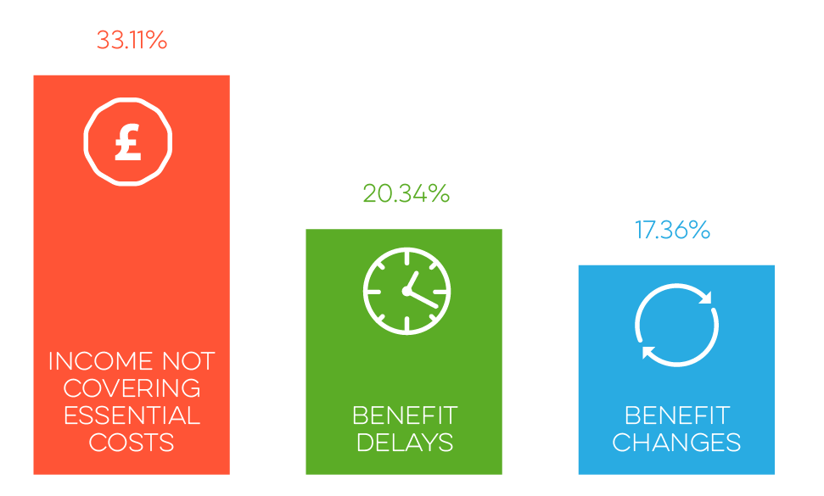
Key issues
Benefits and lack of formal or informal support
Cost of living, sudden illness
Some of the reasons for referral to food banks in the Trussell Trust network
In-work poverty

Slide 4
Leeds Cash Grant Pilot background

Slide 5
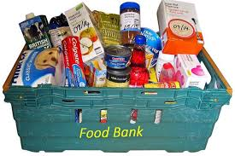
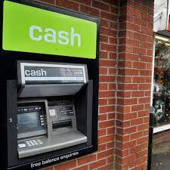
Pilot design

Slide 6
Key Findings from the evaluation report
91% of grant recipients reporting an improvement in their finances while receiving the cash grant.
78% of grant recipients agreed that their ability to afford the essentials improved during the grant period.
94% of grant recipients would prefer a cash grant over a food parcel
81% of grant recipients said that they were fairly/very likely to visit a food bank in the next three months.

Slide 7
“The emotional wellbeing of the grant recipients was generally improved by the cash grant, mainly for the short-term. The cash grant was preferred to using food banks partly because of the negative emotions associated with using food banks. In comparison the cash grant was valued for its flexibility.”

Slide 8
“The freedom of choice of how to spend the cash grant allowed grant recipients to prioritise spending on their immediate needs. The most frequently bought item was food.“

Slide 9
“The cash grant really relieved a lot of stress for me at the hardest financial moment of my life. I was able to put petrol in to get to work, and get some gas and electric etc” - Grant recipient

Slide 10
What do we want to see next?
Robust social security system that protects people from being pulled into destitution
Improved local safety nets in the form of cash-first local welfare provision to support people when they face an immediate financial crisis.

Slide 11
Our cash first recommendations
Accessible and simply application process
Primarily cash first
Advice and support with underlying causes of crisis
Minimal eligibility criteria
Advertised and used before food provision is offered

Slide 12
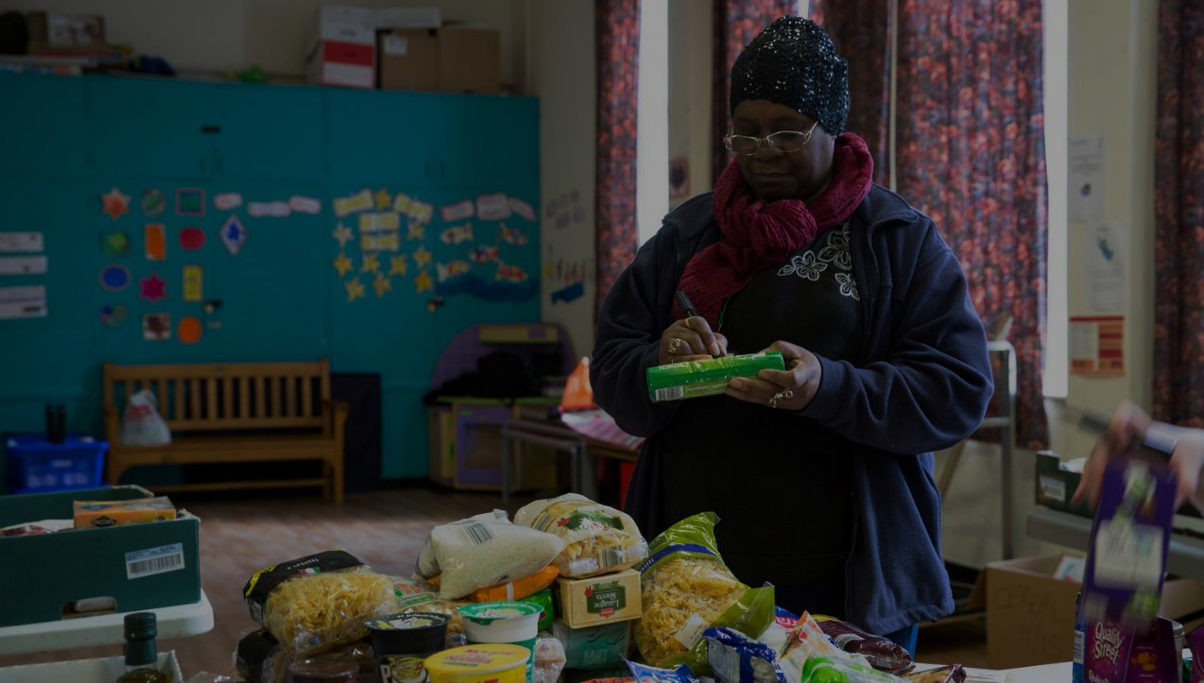
Get Involved
Donate to your local food bank.
Campaign with us for change

