Slide 1
GM Cost of Living Conference Maximising the Impact of Local Welfare Provision
Simon Watts Vicky Powers Corin Hammersley
Public Health Registrar, PH Practitioner & NIHR Research Fellow Advice & Policy Manager Greater Manchester Derbyshire County Council Royal Borough of Greenwich

Slide 2
Aims
Think critically about our local welfare provision and how we can improve and maximise value from it
Share good practice between attendees
Understand different perspectives in how effective current local welfare provision is
Overview of GM research into Welfare Assistance Schemes; Simon
Case Study – Cash Approach to Local Welfare; Vicky
Case Study – Integrating the Welfare Offer; Corin
Further questions and reflections
Housekeeping
Agenda

Slide 3
Context
“Everyone’s depressed as well because you’re just living to get through, to the last day, you’re not actually having fun or having a nice life at all”
What is local welfare ?
Why it is important?
The cost of not providing support
Implications for health
Poverty premium
Why focus on this now?
Research aims and methodology
If LWAS didn’t exist more people would turn to high cost credit, illegal money lenders or crime instead.
“…it was a lifeline, what a great word. I really don’t know what I would have done”
“I was having mental health problems, and if I hadn’t had this to fall back on I would have been, five days a week, sat in my flat with no electric or not being able to cook, and not really having anywhere to turn really”

Slide 4
Findings – A Framework for Improvement
Ownership
Co-location of the scheme with other relevant services could improve efficiency and experience for residents.
A Resident Focused Approach
Focusing on the needs of the resident and the root causes of their financial hardship.
Providing wider support and where necessary linking in closely with other services.
Less about administering grants and more about building relationships and offering support.
Coordinating the Range of Support Available
Local partners come together regularly to discuss and improve LWAS.
Residents and LWAS users at the heart of this.
Drawing on the range of support that local partners provide.
Working with, but not over relying on, third sector support.

Slide 5
Findings – A Framework for Improvement
Eligibility Criteria
Increasing proportion of residents in short term and insecure employment can increase hardship and need for crisis support.
Flexibility required to ensure those in need can access support quickly.
Items/Products Available
‘Cash-first’ approach to improve dignity and maximise, choice and control.
Flexible approach to furniture provision to improve access and efficient use of LWAS funds.
Carpet and fuel voucher availability and the link to fuel poverty, poverty premium and health.
“It (LWAS) helps you get back on your feet, and helps you walk forward after you’ve got on your feet”

Slide 6
Findings – A Framework for Improvement
“It was pretty important that we got the bed because like I said I was seven months pregnant and we were sleeping on sofas”
Resourcing
Postcode lottery
Protect current budget and increase funding where possible
Realise efficiencies identified in the report to improve reach
Communication of Support
Marketing
Language(s) used
Clarity
Application Process
Accessibility – EIA process?
Simplicity
Measuring Success
Using data to drive improvements
It (LWAS) was very important, because moving into my flat I didn’t have anything, they helped me get a bed because I only had a mattress… and to get a cooker…before I got a cooker I was living off sandwiches…so it was better and then my money could stretch a bit further”

Slide 7
Derbyshire Discretionary Fund
Vicky Powers
Public Health Practitioner & NIHR Research Fellow
Notes:
Good afternoon. Today we’d like to speak to you about the Affordable Credit Project, a joint venture between Derbyshire County Council and local Credit Unions.

Slide 8
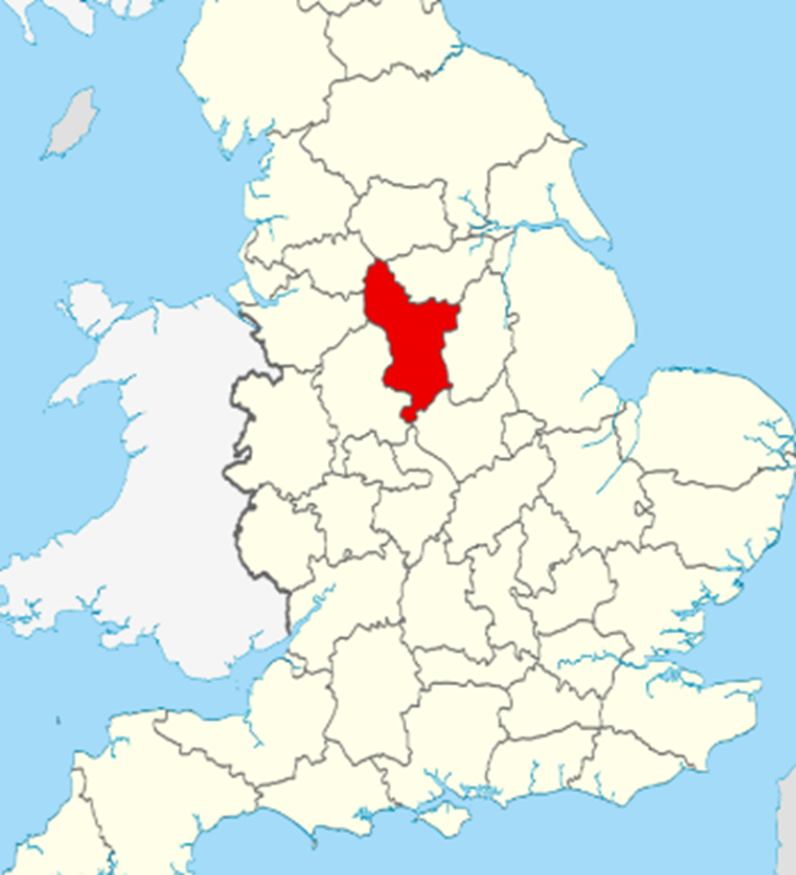
a bit about Derbyshire….
population 796,000
Approx. 1000 sq miles
The majority of residents live in towns and villages - 27% of population live in ‘rural’ areas
Issues of rural poverty and deprived ex-mining towns
No central location – Local Welfare Assistance Scheme had to work in this context
Notes:
73% of population lives in towns and villages -eg Chesterfield is our biggest town – 104,000
Rurality and connectedness is an issue – and has to play a part in how we deliver local welfare assistance.
We cannot say ‘come to the office in the town /city centre’
The network of wider services and VCS provision is varied and localised. Eg 22 individual foodbanks; 4 different CAs; several CVSs
Unemployment overall on the low side – but with a high reliance on the manufacturing sector – almost a 1/5th of our employment.
Average pay in D is 5 or 6 % lower than the national average
98% white – very low minority ethnic populations. The 2nd most spoken language in D is Polish.
Overall D ranks 103 out of 151 upper tier authorities in England (1 being most deprived) – but like everywhere the finer level is more varied
Most of LSOAs in the lower deciles are in the former coalfield areas down the right side of the county – “the M1 corridor”
Overall average life expectancy in D is pretty much on the national average level – but within that, those areas in the lower deciles have significantly lower expectancy
Deprivation shortens lives overall, but it also has a greater impact upon the length of time spent living with poor health and/or with disability.
“Healthy Life Expectancy” in these lower decile areas is some 20 (m) / 25 (w) years less than overall life expectancy.

Slide 9
Derbyshire Discretionary Fund (DDF)
Grant budget £1.3 million per year since 2013
DDF part of Adult Social Care and Health Directorate
From July 2019 moved into Public Health dept– Financial Inclusion Team alongside Welfare Rights Service
Two types of application
Emergency Cash Payment
Exceptional Pressure Grant
Roughly aligned to previous provision by DWP
Notes:
Each upper tier authority developed its own path on LWA.
Our initial brief was to operate as closely as we could to the DWP provision of crisis payments that had previously operated.
Aligning with the Public Health agenda has created opportunities for us to work more closely with colleagues around the ‘wider determinants of health’
We are just beginning to develop this work and re-shaping our local welfare assistance offer is part of that.

Slide 10
Emergency Cash Payments
Payments for food, heating and emergency travel if there is a risk to the health and safety of the applicant or their family
£54 for single person, £10 each affected family member
Maximum 3 awards in a year
Payments made in cash – applicant receives a text message with a voucher code that can be cashed at the Post Office
Target 3 days, most applications turned around in 24 hours
Notes:
£54 was 75% of a single person mtb rate in 2014.
Payments are transacted through local Post Offices – we send a text to the applicant’s mobile phone which the Post Office use to validate and make a payment of cash.
That element works very smoothly and is viable across our rural geography.

Slide 11
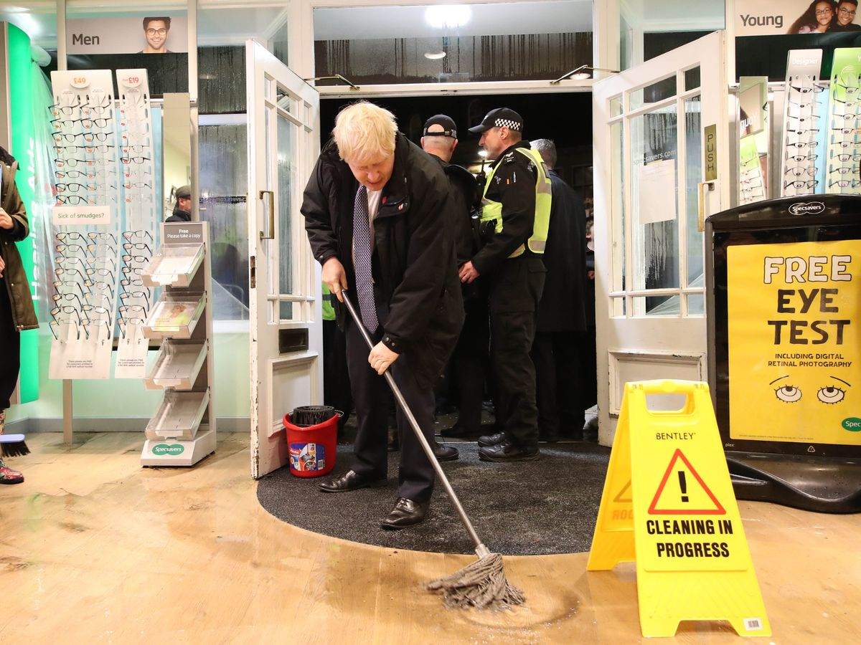
Hardship Fund
DDF is also used to administer hardship payments enabling swift response at times of emergency e.g. Toddbrook Reservoir, widespread flooding
Payment mechanism supports other services e.g. Covid Support Payments, Homes for Ukraine

Slide 12
Household Support Fund
Funding for local authorities in response to rising cost of energy
3 tranches (Oct 21-April 22; April 22-Sept 22; Oct 22-April 23)
Mixed provision – free school meals vouchers, pensioner payments, VCS targeted funding
Household Support Grant funding has allowed DDF to
increase amount of payments (£64 + £20);
extend the number of awards allowed (additional 2 payments in each phase of “HSF1” and “HSF2”); and
operate a more flexible decision making criteria
Notes:
£54 was 75% of a single person mtb rate in 2014.
Payments are transacted through local Post Offices – we send a text to the applicant’s mobile phone which the Post Office use to validate and make a payment of cash.
That element works very smoothly and is viable across our rural geography.

Slide 13
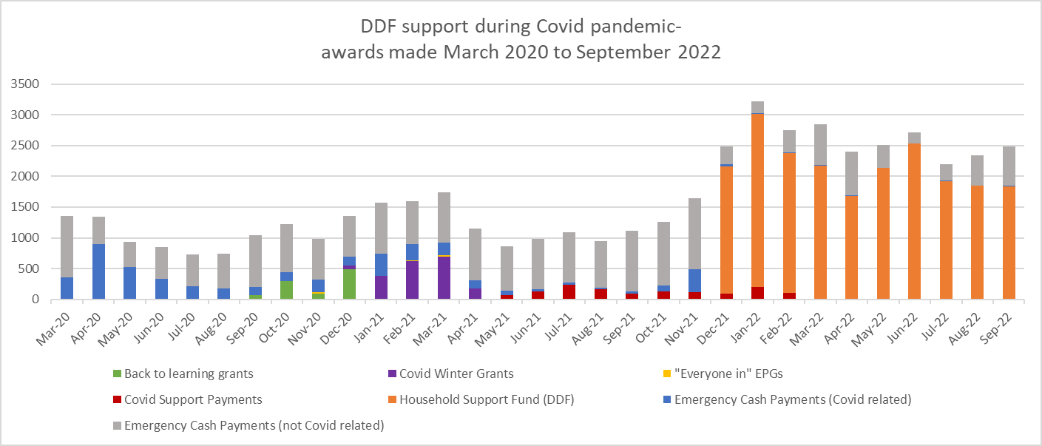
DDF support from March 2020

Slide 14
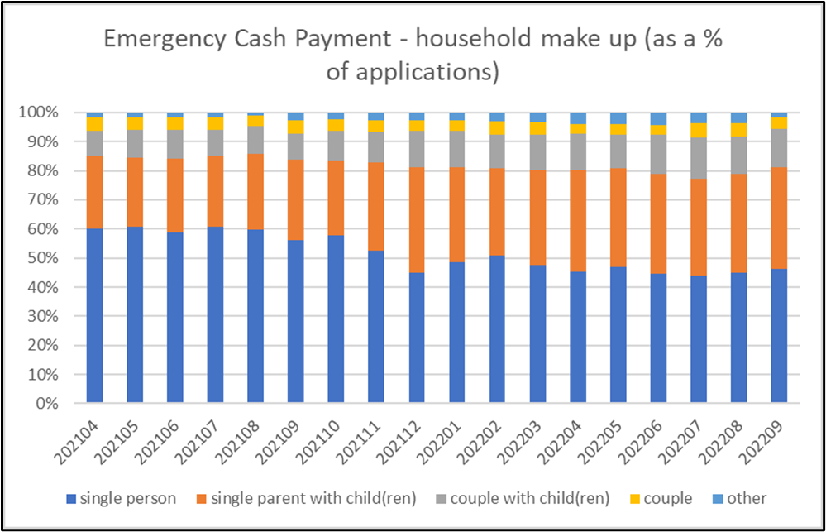
ECP applicants
New applicants to DDF around 10% of applications each month
Growth in new applicants since start of Household Support Fund from ~120 to 300+
Particular growth in applications from single parents – both in real terms and as proportion of applicants

Slide 15
ECP – reasons for applying
budgeting pressure
unexpected bill or expense
benefit sanctions
Now the most common reason for applying
Increase by 3x since Oct 2021
Increase by 2x since Oct 2021
3x as many applications due to sanctions compared to 2019 – (although this is still lower than 2014)
49% of awards in last twelve months were from applicants living in the 20% most deprived areas of Derbyshire

Slide 16
Repeat awards
Average number of awards pre-Covid was 1.8 per applicant (max 3)
Average number of awards is 2.4 per applicant since introduction of HSF (max 3+ 2 +2)
Applications declined because at max awards currently at 7% (Sept 22)

Slide 17
Applicant feedback
88% felt the award helped them to feel less stressed
Really good thing to have when people are struggling /desperate
Really pleased and everyone worked together
Many thanks for prompt payment
57% felt the award helped them to cope with health problems
66% felt the award helped them to eat healthier
It was an excellent service, I would have turned to payday loans as last resort
It’s a good service- waiting time for calls to answered are long but that is to be expected under the current inflation and rising food and energy prices. I am grateful for the service I have received - thank you
The post office was the most convenient way they could have sent the money, so I am happy
55% felt the award improved children’s wellbeing

Slide 18
Maximising impact of Local Welfare Assistance schemes
Corin Hammersley
Advice & Policy Manager, Royal Borough of Greenwich

Slide 19
Advice & Benefits
Advice & Policy Manager
Welfare Rights Service
Universal Support Team
Money Advice Service (temporary)
Emergency Support Scheme

Slide 20
Emergency Support Scheme (ESS)
When set up in 2013, largely mirrored on crisis loans and community care grants.
Key features:
Discretionary decisions
Emergency awards are cash grants, typically between £30-300
Community awards are goods/furniture/services
Scheme made permanent in February 2020, with £750k budget (for both expenditure and administration)
In 19/20, the scheme awarded £395k across both schemes, receiving approx 250 applications per month.
Referral route between ESS and WRS, although (pre-pandemic) not as many referrals as I had expected

Slide 21
ESS stats
 | Number of claims | Total awarded
19/20 | 3771 | £394,990
20/21 | 4993 | £520,779
21/22 | 5142 | £643,497
22/23 | 3384 (six months) | £493,799 (six months)

Slide 22
Household Support Grant
FSM provision during school holidays, extended to pre-school children (in 21/22, this amounted to £195 per child)
Targeted payments to other groups (currently care leavers, households supported by NRPF team)
Applications via our ESS scheme
Small community grants scheme
Direct food and energy support provision through partners

Slide 23
Our approach to supporting clients
Money Advice
Emergency Support
Welfare Rights

Slide 24
Case studies
Client referred to MAS after second claim for ESS. She was lone parent with two young children, one with autism. Had just received DLA middle rate award. Currently living in temporary accommodation (had been placed by neighbouring borough into Greenwich).
Identified entitlement to carers allowance, disabled child element on UC, exemption from benefit cap, and had not applied for council tax support (was able to backdate this). Monthly income increased £418.
Completed SFS. Advised to switch to social tariffs for broadband and mobile phone. Negotiated a deduction being applied to her UC for historical social fund loan from £39.80 to £10pm. Backdating of CTS cleared outstanding council tax debt.
Assisted to make another ESS application to meet immediate needs (awarded £100) as we were resolving the above issues.

Slide 25
Case studies
Client presented at an outreach hub for help with applying for the energy rebate payment but other issues were identified at triage; Housing Benefit had been suspended for approx. 3 months, and she only had PIP for income.
Adviser supported client to contact GP for sick note info and submitted an ESS application due to her immediate financial need. £200 was awarded. Adviser was also able to get Housing Benefit and Council Tax Support reinstated as well as establish an ESA claim for her going forward.
Client referred across from ESS into Money Advice. Through joint working with WRS, we were able to identify missed severe disability premium of 30k.

Slide 26
Final Reflections and Questions
Questions?
What are your experiences of local welfare assistance working together with the voluntary community sector?
Comms: How can we get better at talking about what we do and provide?
What are the opportunities and/or challenges in your area to improving local welfare?
The importance of seeing health and income deprivation as interrelated issues.
The health implications of not getting welfare and crisis support right are significant.
Good welfare support was protective for mental health during the last recession – it can help stop health inequalities widening further.
Working with residents on the root causes of hardship can narrow inequalities.

Slide 27
Further Reading
GMPA – Strengthening the Role of Local Welfare Assistance
LGA - Good practice guide: Delivering financial hardship support schemes
CPAG – Cash in Crisis
Children’s Society – Strengthening Local Welfare Assistance During Covid-19
Policy in Practice Report on LWAS in London – due imminently

Slide 28
Appendix: Checklist from GMPA LWAS Research
Short self-audit checklist for your LWAS:
Question/Area |  | Answer | Notes/Actions
1 | Do you have a forum or group containing partners described in section 6C where LWAS can be discussed and is a regular agenda item?
2 | Is there a mechanism for capturing resident and LWAS users’ feedback to feed into this group/forum?
3 | Have you reviewed where your LWAS sits within your local authority? Could there be efficiencies (as described in section 6A) by moving it to a different area?
4 | To what extent is your LWAS support focused around the challenges and needs of residents? Can individuals receive wider advice/support as part of contacting the LWAS team? See section 6B for details about a case worker approach.
5 | Is LWAS advice and support offered in local neighbourhoods, close to those in most need?
6 | Are your eligibility criteria for the LWAS flexible enough to ensure that residents in financial crisis can receive an element of support when appropriate?
7 | Does your organisation adopt a flexible approach to offering cash to welfare applicants where appropriate to preserve choice, dignity and control?
8 | Have you recently reviewed how your LWAS provides furniture in the region? Provision could be improved and efficiencies made by considering options outlined in section 6E/appendix 2.
9 | Is your LWAS easy to apply for, requesting the minimum about of information necessary? See section 6H.
10 | Is your welfare application available in other languages relevant to your area?
11 | Is there a phone number advertised on the welfare application page for residents who may struggle to fill out the form?
12 | Is your welfare support clearly and proactively communicated to partners and residents? Has the web content relating to LWAS, as well as other benefits including Council Tax Support and DHP been reviewed for clarity of communication?
13 | Can migrants or asylum seekers access council funded LWAS? If not, is there a clear plan of other services they can access to support them?
14 | Has a multi-year commitment been made to funding the LWAS and is that funding protected going forwards?
15 | Do you measure outcomes relating to the LWAS as well as outputs? Are these metrics seen by key partners outlined in section 6C and do they feed into local authority governance around poverty reduction? Section 6I outlines metrics that could be reported on.
16 | Are measures to prevent hardship regularly explored, to include those detailed in section 7.
17 | Have discussions taken place with local credit union(s) about how their offer can be tailored to meet residents’ needs? See section 7C.

